Slide 1
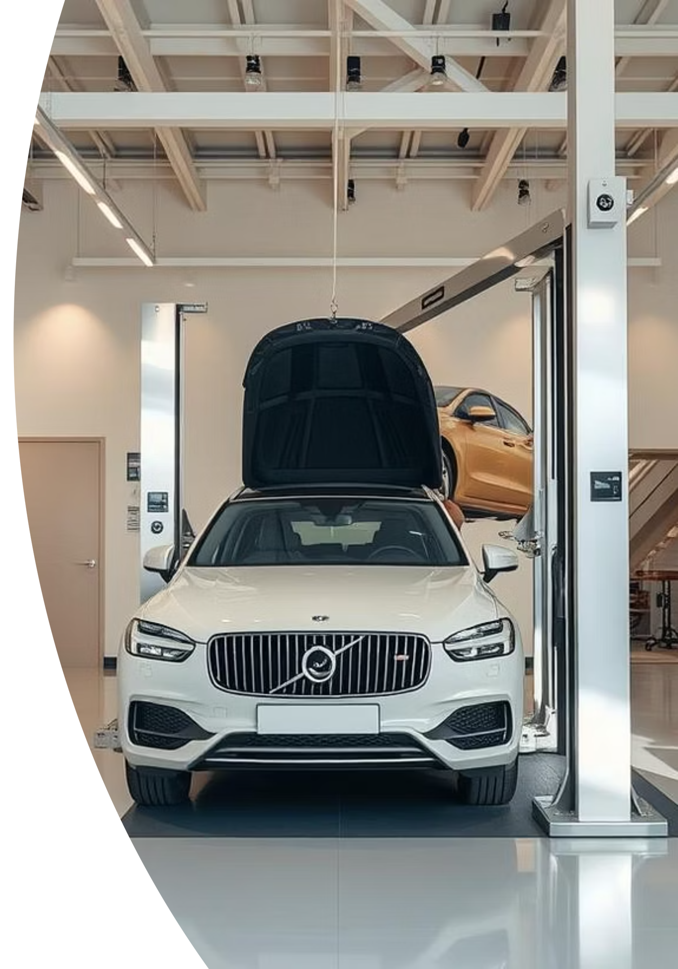
Car Evaluation Using Machine Learning
Name: Bovas Benson
Course: MGT-665-NW – Solving Problems with Machine Learning
Date: July 8th, 2025

Slide 2





Abstract
This project uses machine learning to predict car acceptability using 7 categorical features.
Five classification models were compared.
SVM achieved best accuracy: 96.8%
Visualizations support interpretation: confusion matrices, bar plots.

Slide 3



Introduction
Traditional evaluations rely on subjective opinions.
ML provides consistent, scalable decisions.
Goal: Predict car acceptability using models like SVM, k-NN, Random Forest, etc.

Slide 4
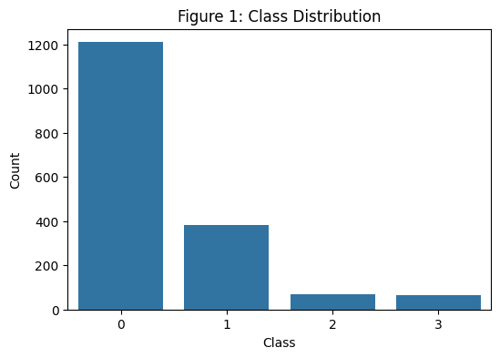
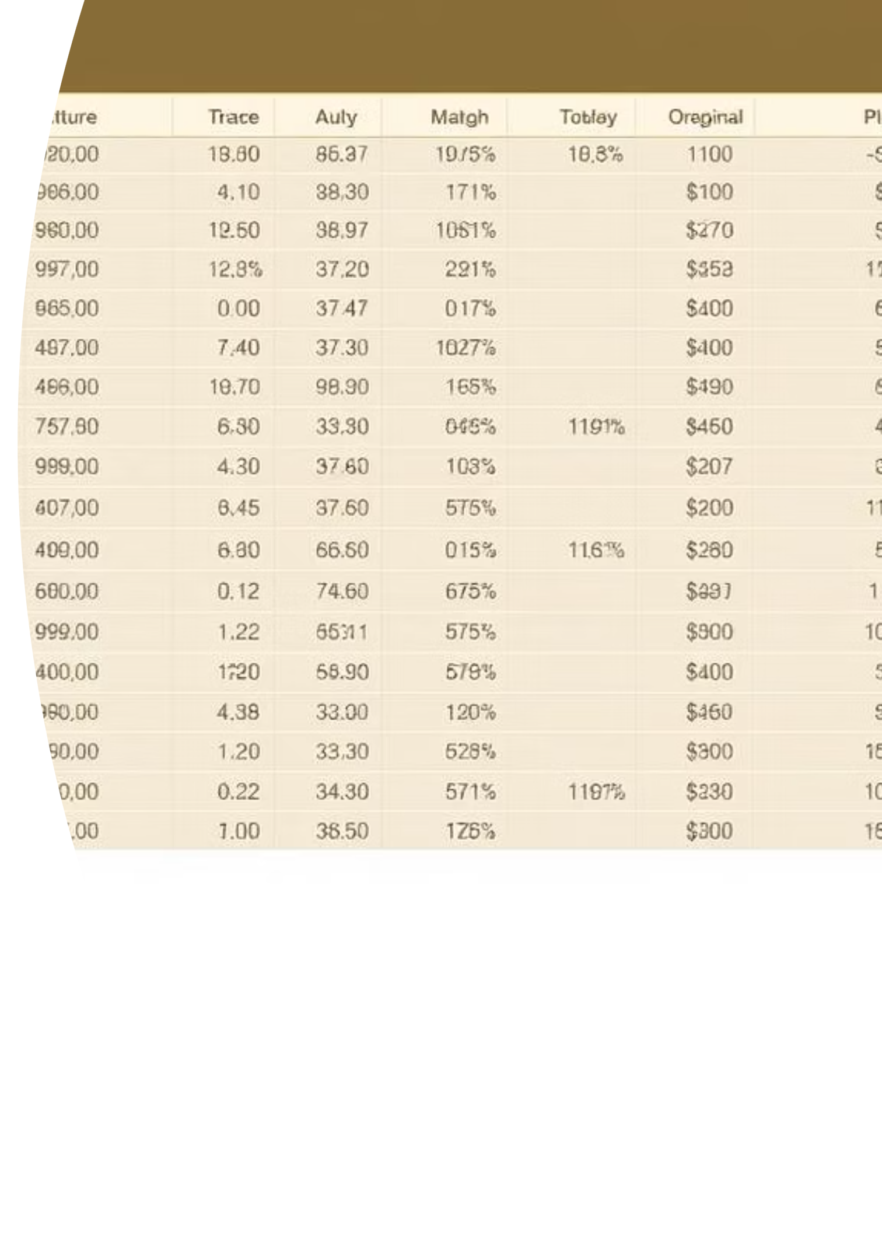
Dataset Summary
Dataset: 1,728 rows, 7 categorical features
No missing values
Label encoding used for preprocessing
Features: buying, maintenance, doors, persons, lug_boot, safety, class

Slide 5
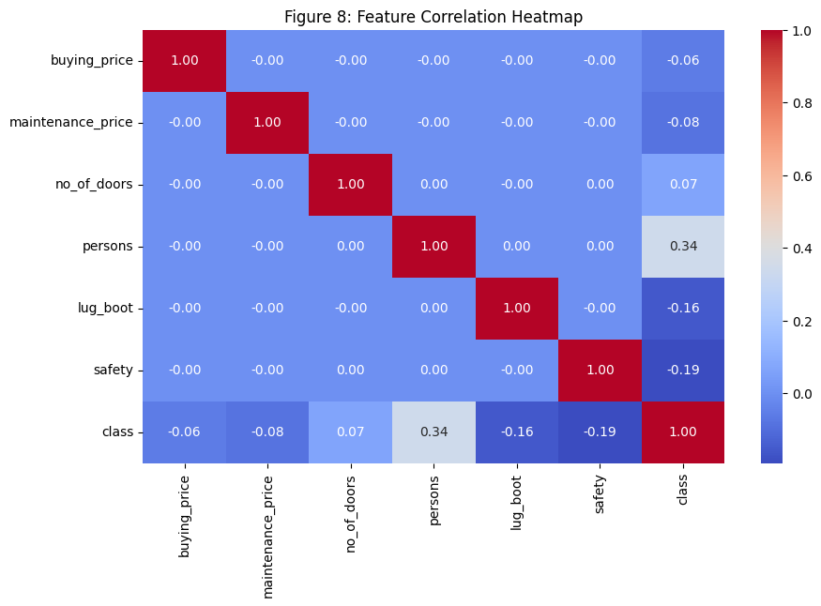
EDA – Feature Trends
Class imbalance: 'unacceptable' is dominant
High safety and low price increase acceptability
Correlation matrix showed buying price & safety are predictive

Slide 6

Models Used
Five classifiers:
Evaluation metrics: Accuracy & F1-score
Logistic Regression
Train/Test split: 80/20
k-NN
Decision Tree
Random Forest
SVM

Slide 7
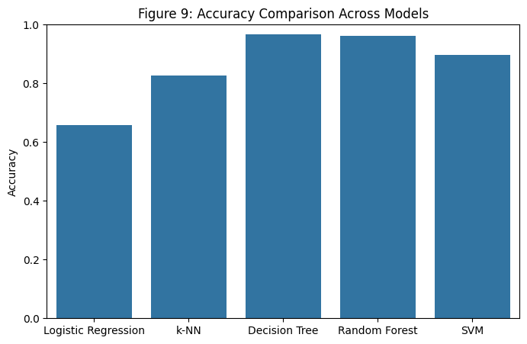



Model Accuracy Comparison
SVM achieved highest accuracy: 96.8%
Random Forest & Decision Tree were close
Logistic Regression and k-NN struggled with minority classes

Slide 8
Full Accuracy & F1 Score Table
Logistic Regression
0.659
0.593
k-NN
0.827
0.804
Decision Tree
0.968
0.971
Random Forest
0.962
0.964
SVM
0.896
0.889

Slide 9
SVM Hyperparameter Tuning
GridSearchCV used to fine-tune SVM
Best parameters:
Improved precision and recall, especially on minority classes
C = 10
Kernel = 'rbf'
Gamma = 'scale'

Slide 10
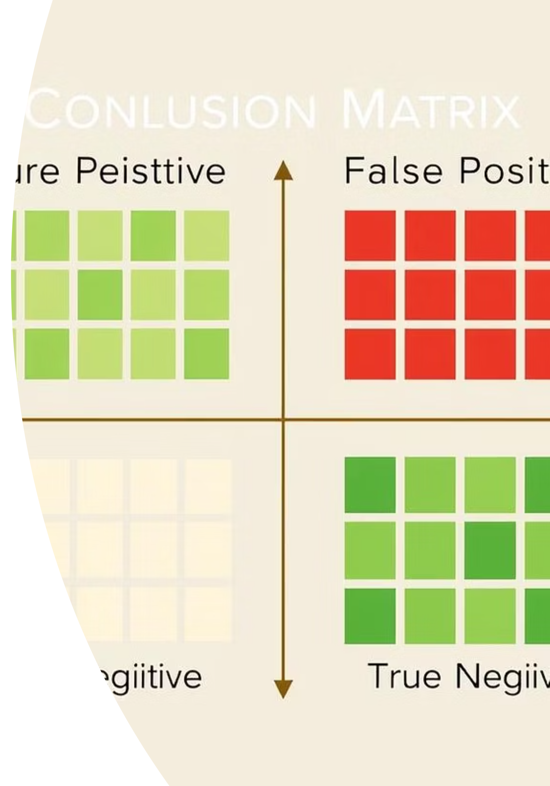
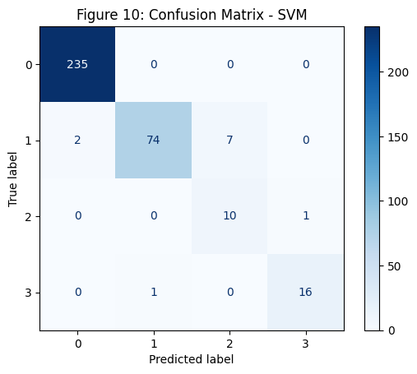
Confusion Matrix – SVM
Most predictions were accurate
Misclassifications were minimal
High precision and recall for all classes

Slide 11

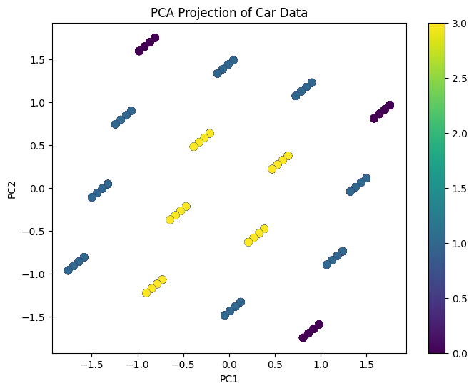
PCA – 2D Projection
PCA reduced high-dimensional data to 2D
Some separation between classes visible
Useful for visualization, not clustering

Slide 12

PCA – Explained Variance
90%
8%
2%
PC1
PC2
Remaining
Captures the majority of the data's variance.
Accounts for a significant portion of the remaining variance.
Minor variance captured by subsequent components.
Most structure is captured in first 2 components

Slide 13
Discussion
SVM Performance
Tree-based Models
SVM gave best balance between accuracy and generalization
Tree-based models also performed well
k-NN Challenges
Logistic Regression
k-NN struggled with categorical data
Logistic Regression was weaker on minority classes

Slide 14
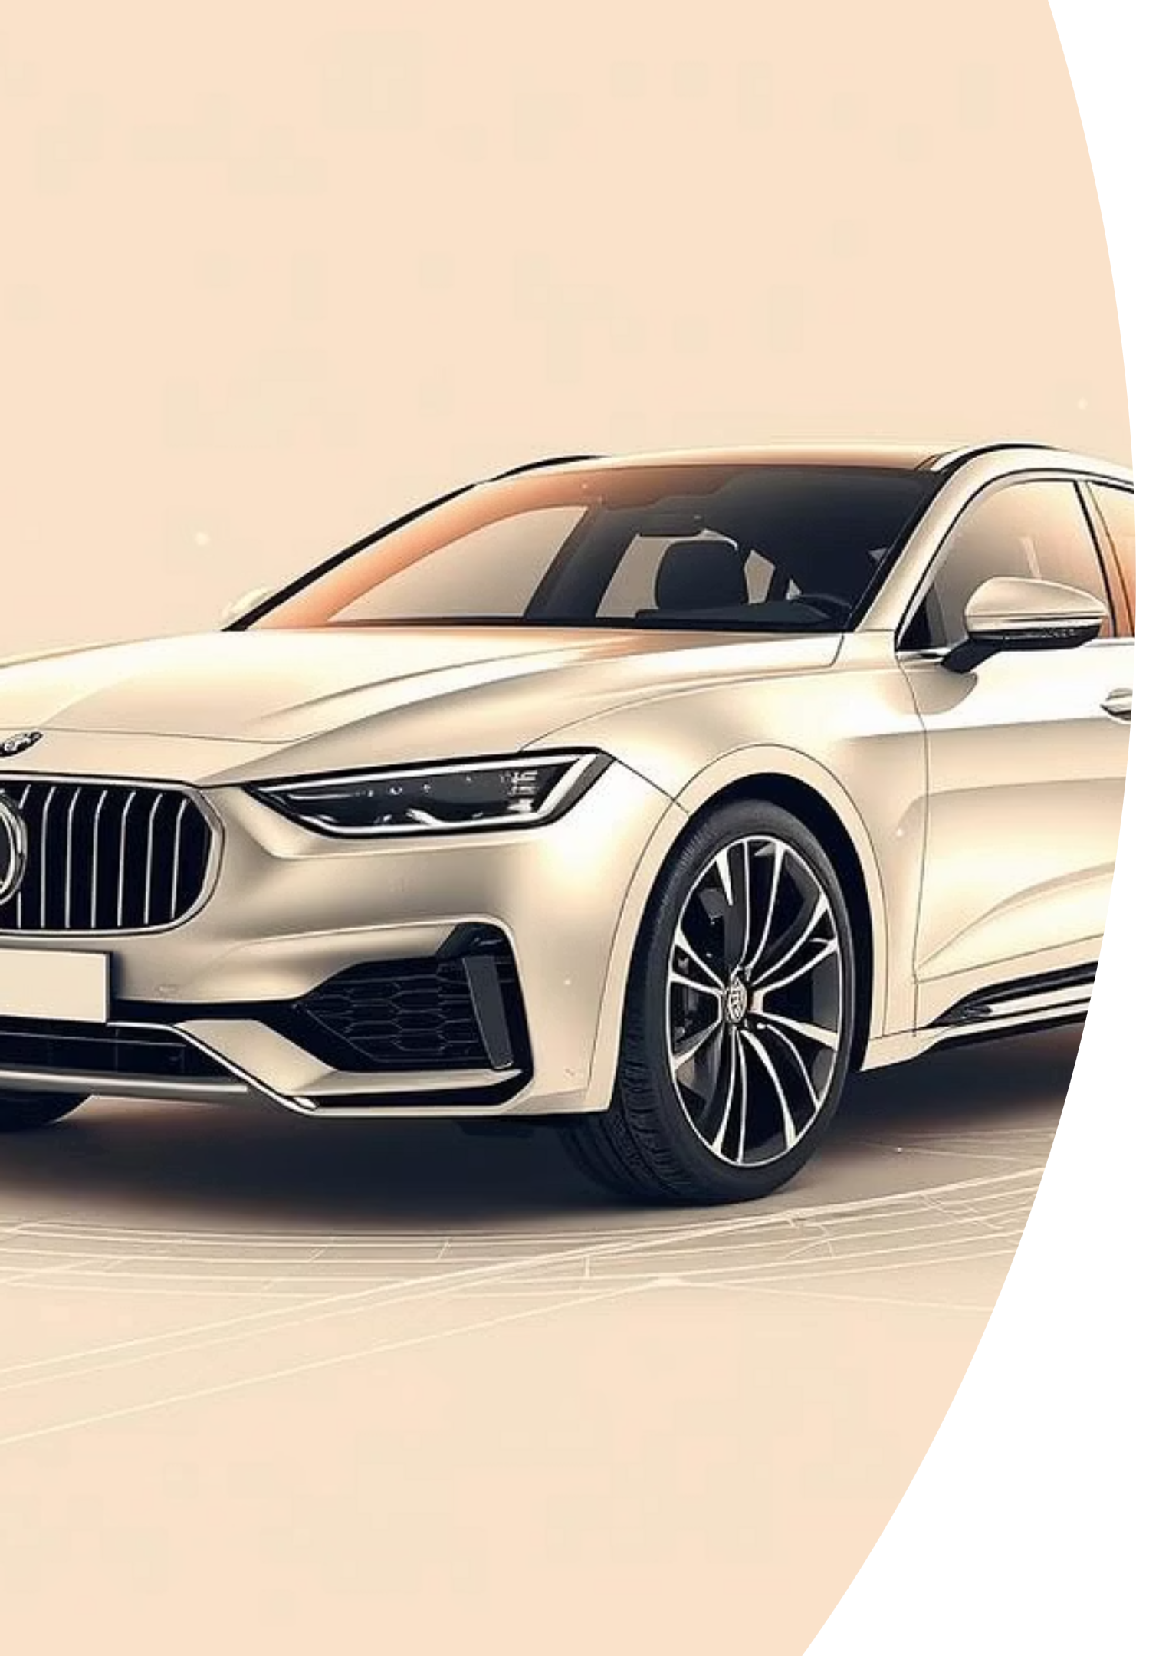
Conclusion
SVM is best suited for car acceptability classification
Visualizations helped interpret results
ML is effective for structured decision-making in this domain

Slide 15
Future Work
Model Exploration
Feature Engineering
Explore ensemble models for improved accuracy
Data Balancing
Add continuous features (e.g., fuel economy)
Apply SMOTE or class weighting

Slide 16
Thank You

